Slide 1



Earthquake
Kookmin University
Rak jun Choi
MinHyuk Jang
Younjae Oh

Slide 2

Team Member
Topic
Selection Process
Contents
Game Demonstration
Tool & Skill
Epilogue

Slide 3
1
Team

Slide 4



Team Members
Younjae Oh MinHyuk Jang Rak Jun Choi
(Freshman) (Freshman) (Sophomore)

Slide 5
2
Topic
Selecting Process

Slide 6
Topic Selecting Process
Game
Helping to recover mental illness
PTSD(Post Traumatic Stress disorder)
PTSD from car accident
Education Program
Prevent PTSD from car accident
Evacuation from earthquake

Slide 7

3
Program
Demonstration

Slide 8
4
Tool & Skill

Slide 9



1. Tools

Slide 10
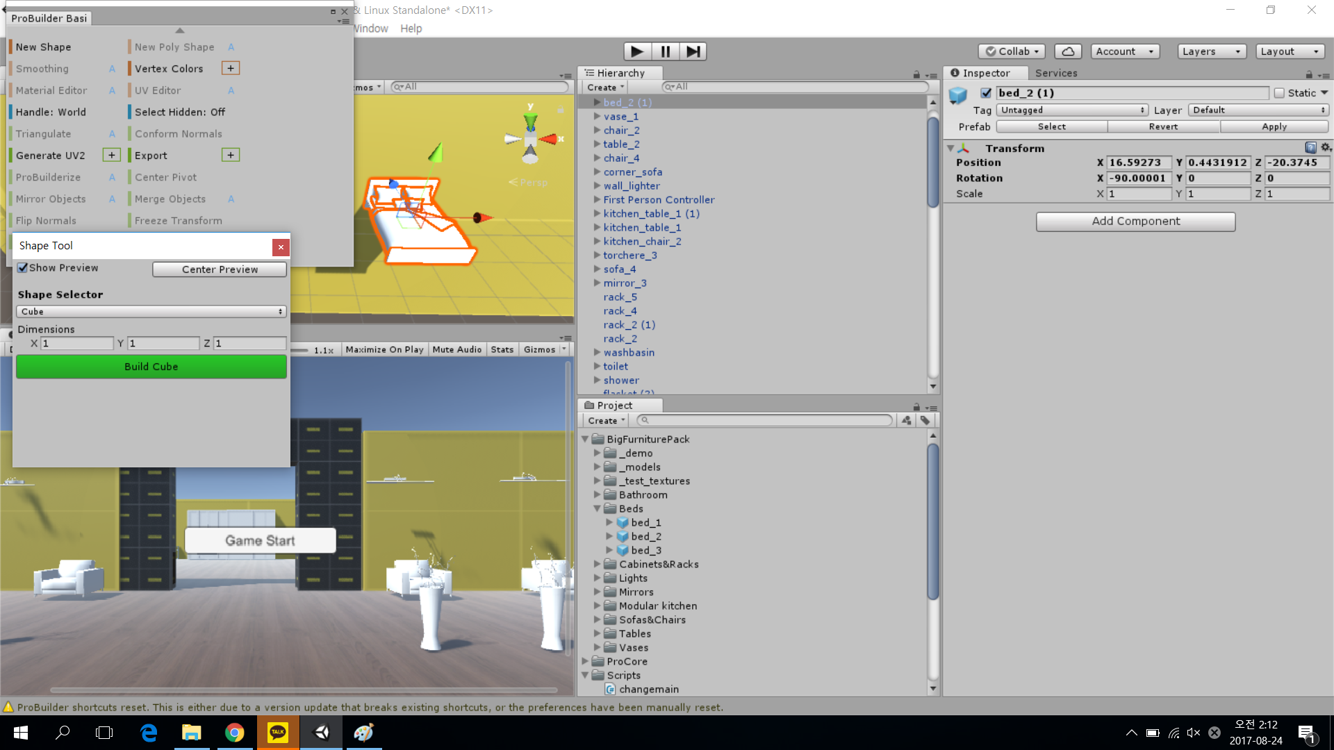
2. Skills
Set up Furniture

Slide 11
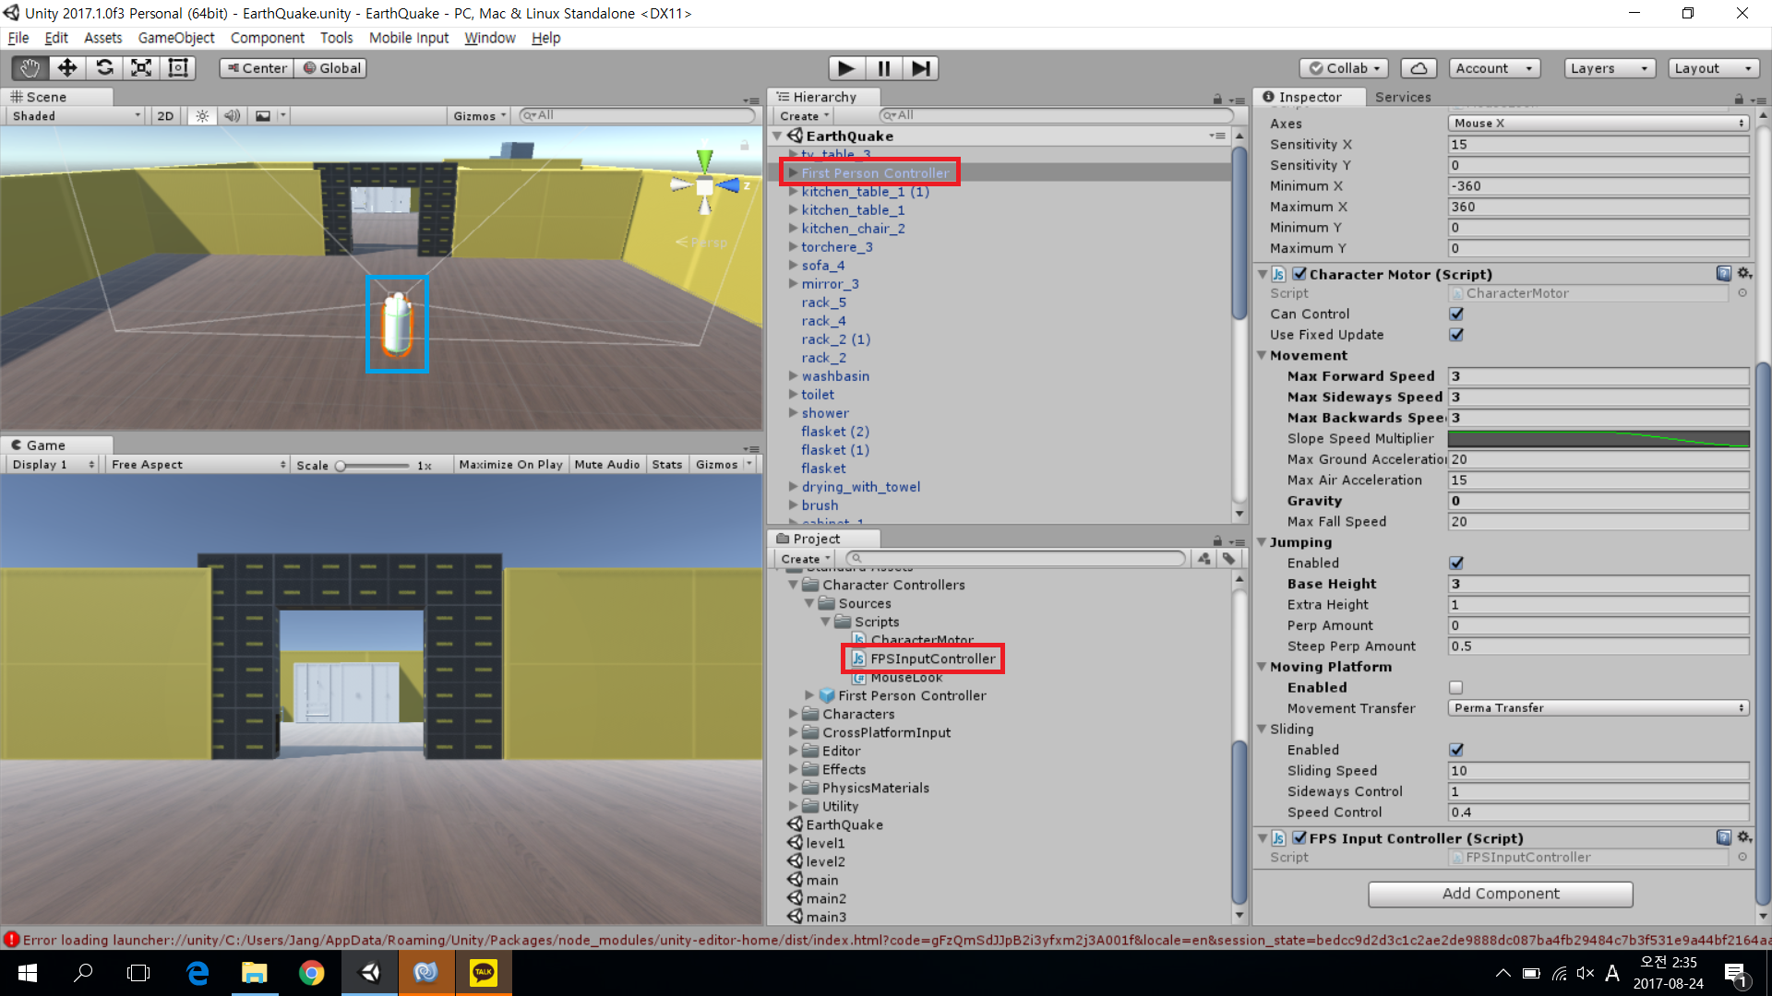
2. Skills
First Person Camera

Slide 12
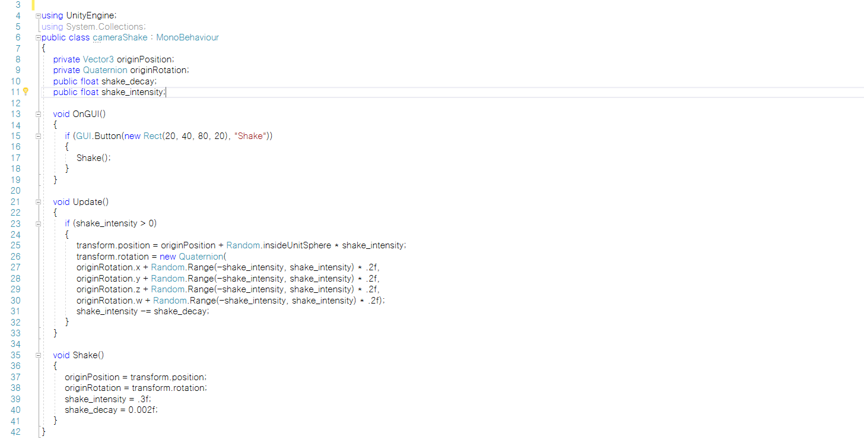
2. Skills
Shaking Effect

Slide 13
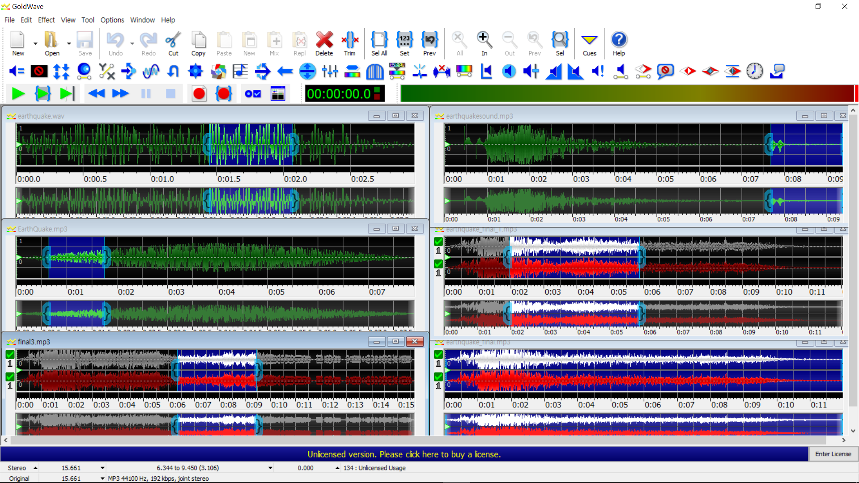
2. Skills
Making earthquake sound

Slide 14
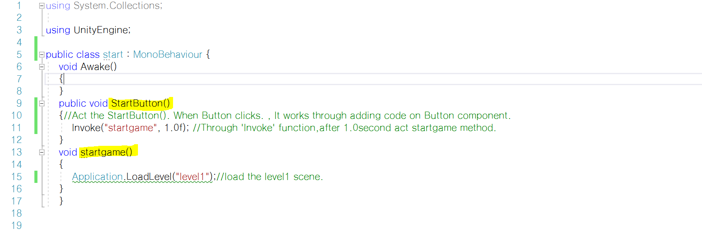
2. Skills
Using Start Button

Slide 15
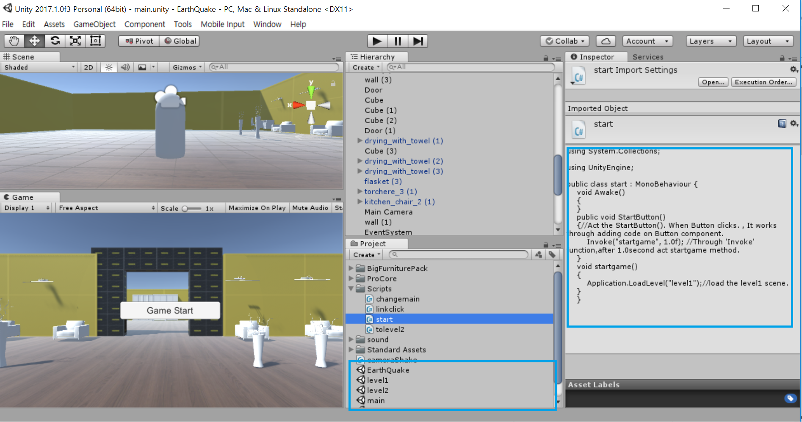
2. Skills
Changing First Scene

Slide 16
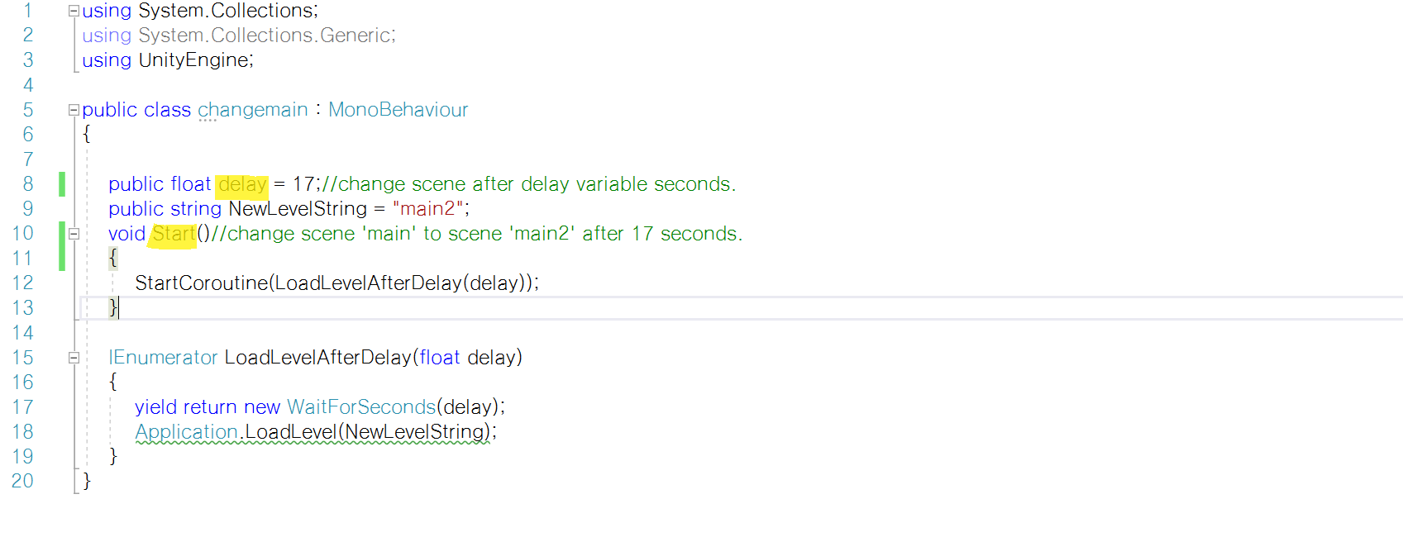
2. Skills
Changing Second Scene with a Button - Script

Slide 17
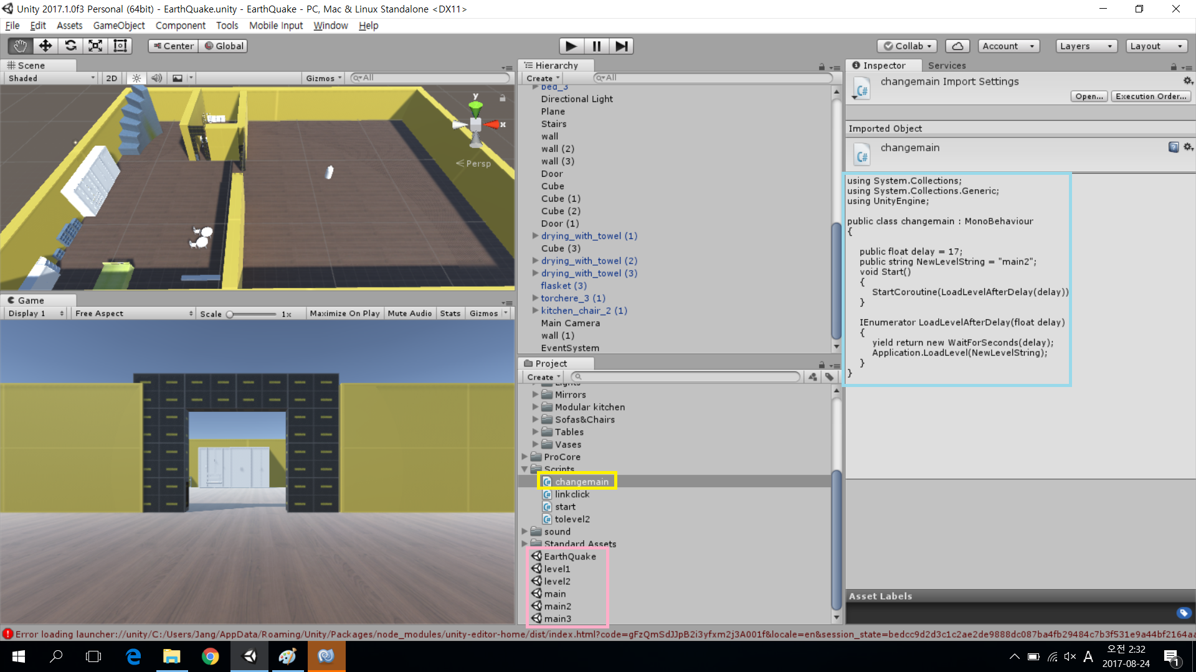
2. Skills
Changing Second Scene with a Button

Slide 18
5
Epilogue

Slide 19
Reference
Making a house
https://www.youtube.com/watch?v=Ta3HkV_qHTc
https://www.youtube.com/watch?v=Ax3hWJtmkPY
https://www.youtube.com/watch?v=ll7PpGXuHwI
Set up Furniture
https://www.youtube.com/watch?v=Ta3HkV_qHTc
https://www.youtube.com/watch?v=Ax3hWJtmkPY
https://www.youtube.com/watch?v=ll7PpGXuHwI
How to use First Person Camera
https://www.youtube.com/watch?v=lmLG4nC9tm0
https://www.youtube.com/watch?v=Ct4L1az-L7s
Hot to use Scene change & Scene Manager (with limit time)
https://www.youtube.com/watch?v=d7h49NKooKU
https://www.youtube.com/watch?v=d3AoNgqDXCI
Control Mouse Speed
https://www.youtube.com/watch?v=riX1wv0JYv0

Slide 20
Reference
Learn Unity
http://unity3.com/kr/learn/tutorials
Adding Sound effect
http://forum.unity3d.com/threads/simple-first-person-camera-script.417611
Making Background Sound
http://udcreplay.nexon.com/NDC2017

Slide 21
Q&A

Slide 22
THANK YOU

